Slide 1

Predictor
Owen Rafferty

Slide 2
Project Idea
I wanted to create a UFC fight predictor based on this kaggle dataset. The idea is we will build a deep learning model with tensorflow that can see if the red fighter will win or lose a match.

Slide 3
The Data
This dataset holds all fights from the beginning of the ufc in 1993 to june of 2019. For the cleaning of this data it was a very well put together dataframe so I only had to do a few things. First was to drop all fights before the rules for the ufc were put into place. Then I dropped all draws and all rows that contained any nan values since there was no accurate way to replace that data.

Slide 4
EDA Visualizations
For my eda I did not make too many graphs as I mostly needed to just understand all the data in my dataset which was better represented I felt by mostly looking at the describe() method. All the data was pretty much about the fighter stats throughout that fight with a few outliers like the names, referee, location, weight class, and if it was a title bout or not. I did find through my 2 heat maps that you can see by clicking the visualization link that the data frame as a whole did not give much info about the fights but looking at a individual fighters heat map you can see that he has certain strengths and weaknesses when fighting which is one of the reasons I choose to encode all the fighters names for my model

Slide 5
Columns
'R_fighter', 'B_fighter', 'Referee', 'date', 'location', 'Winner', 'title_bout', 'weight_class', 'no_of_rounds', 'R_current_lose_streak', 'R_current_win_streak', 'R_draw', 'R_avg_BODY_att', 'R_avg_BODY_landed', 'R_avg_CLINCH_att', 'R_avg_CLINCH_landed', 'R_avg_DISTANCE_att', 'R_avg_DISTANCE_landed', 'R_avg_GROUND_att', 'R_avg_GROUND_landed', 'R_avg_HEAD_att', 'R_avg_HEAD_landed', 'R_avg_KD', 'R_avg_LEG_att', 'R_avg_LEG_landed', 'R_avg_PASS', 'R_avg_REV', 'R_avg_SIG_STR_att', 'R_avg_SIG_STR_landed', 'R_avg_SIG_STR_pct', 'R_avg_SUB_ATT', 'R_avg_TD_att', 'R_avg_TD_landed', 'R_avg_TD_pct', 'R_avg_TOTAL_STR_att', 'R_avg_TOTAL_STR_landed', 'R_longest_win_streak', 'R_losses', 'R_avg_opp_BODY_att', 'R_avg_opp_BODY_landed', 'R_avg_opp_CLINCH_att', 'R_avg_opp_CLINCH_landed', 'R_avg_opp_DISTANCE_att', 'R_avg_opp_DISTANCE_landed', 'R_avg_opp_GROUND_att', 'R_avg_opp_GROUND_landed', 'R_avg_opp_HEAD_att', 'R_avg_opp_HEAD_landed', 'R_avg_opp_KD', 'R_avg_opp_LEG_att', 'R_avg_opp_LEG_landed', 'R_avg_opp_PASS', 'R_avg_opp_REV', 'R_avg_opp_SIG_STR_att', 'R_avg_opp_SIG_STR_landed', 'R_avg_opp_SIG_STR_pct', 'R_avg_opp_SUB_ATT', 'R_avg_opp_TD_att', 'R_avg_opp_TD_landed', 'R_avg_opp_TD_pct', 'R_avg_opp_TOTAL_STR_att', 'R_avg_opp_TOTAL_STR_landed', 'R_total_rounds_fought', 'R_total_time_fought(seconds)', 'R_total_title_bouts', 'R_win_by_Decision_Majority', 'R_win_by_Decision_Split', 'R_win_by_Decision_Unanimous', 'R_win_by_KO/TKO', 'R_win_by_Submission', 'R_win_by_TKO_Doctor_Stoppage', 'R_wins', 'R_Stance', 'R_Height_cms', 'R_Reach_cms', 'R_Weight_lbs', 'R_age'
This data frame consisted of a lot of columns theses are about half as for every column that begins with R there is another one the begins with B describing the blue fighters stats.

Slide 6
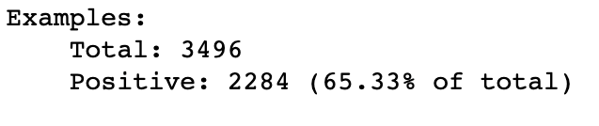
Feature tuning
Since as I said before I am using a tensorflow deep learning model I made sure all the data was converted into numbers and did some analysis to see that 65% of the data set was all red wins so it is skewed more towards the red fighter winning for sure.

Slide 7
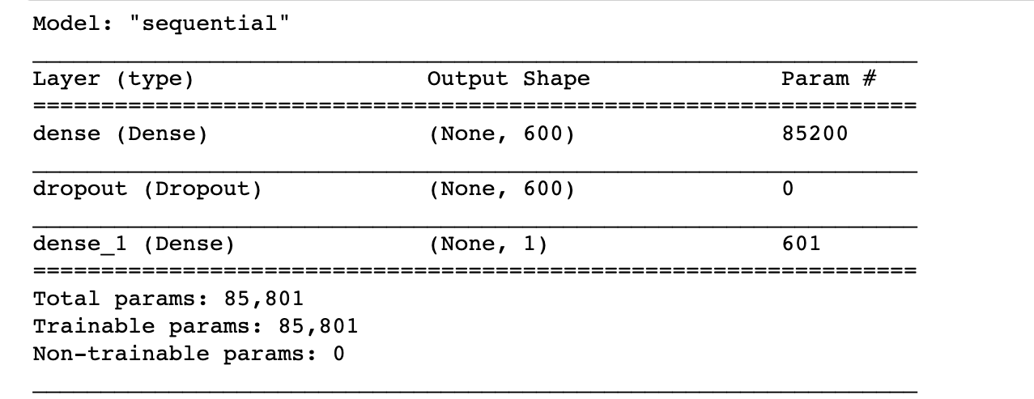
Models
I created 2 Deep learning models one with just initial weights and another with initial/class weights. Both models followed the same basic structure as follows.

Slide 8
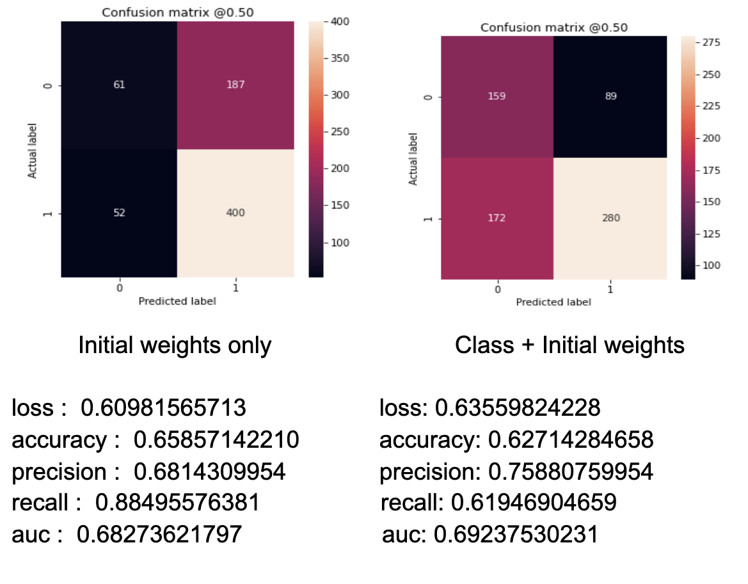
Models stats

Slide 9
Feature Analysis
Using shap for my feature analysis it showed me exactly what I was expecting or even better for some features. Most features that benefitted the blue fighter would negatively impact the model while the features correlated to the red fighter would usually positively impact the model.

Slide 10
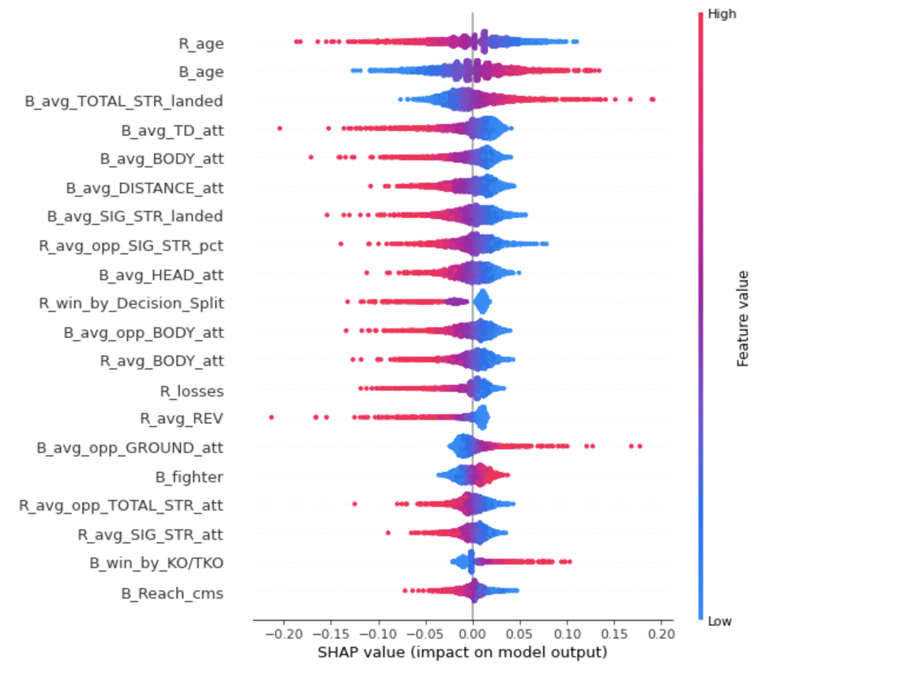
Feature Analysis

Slide 11
Conclusion
My model is fairly good at predicting when a red fighter wins but not so good at when a blue fighter wins. The winner column is based on the red fighter winning so it does make sense but I would like to make a more even model if I could eventually. I would also like to play around with the making of the model more maybe adding a tanh activation layer just to see how it can affect my model for positive or worse. To sum it up I think this predictor came out ok I was hoping to get a little more out of my model and this project but with the time constraints/how hard it was making my first tensorflow model it came out ok all in all.

